Slide 1
Jermyn Borough Council Meeting
7/27/2023

Slide 2
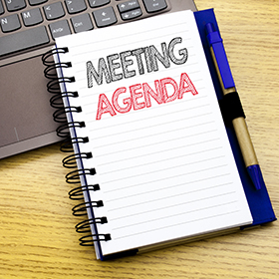
Meeting Agenda
July 27 ,2023
CALL TO ORDER
PLEDGE OF ALLEGIANCE
ROLL CALL
PREVIOUS MEETING MINUTES
TREASURER REPORT/BILLS PAYABLE
SECRETARY REPORT
CORRESPONDENCE
PUBLIC COMMMENT
PROFESSIONAL REPORTS-POLICE, FIRE, SOLICITOR, ZONING, ENGINEER, TAX COLLECTOR, MAYOR
COMMITTEE REPORTS-SAFETY, PLANNING, FINANCE, SHADE TREE, REC, MS4, DPW
MASCARO
DCED CFA MULTIMODAL TRANSPORTATION FUND APPLICATION
RIVERVIEW WINERY
PROPERTY UPKEEP IN THE BOROUGH
MELLOW COURT FOLLOW UP
NEW BUSINESS

Slide 3
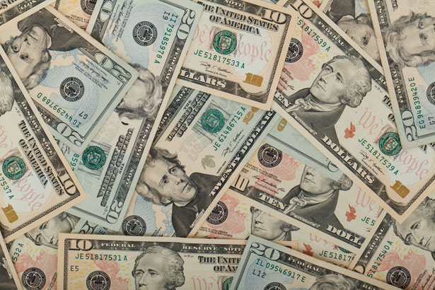
Treasurer’s report
7/27/2023
ASSETS
Checking/Savings
American Rescue Plan Fund 135,720.13
Capital Reserve - DPW 10,729.15
Capital Reserve - Police 5,269.82
Crime Watch Fund 222.69
General Fund - Community 242,689.80
General Fund - FNB 6,558.31
Holiday Lights Fund 1,459.09

Slide 4
Treasurer’s report
Investment - General Fund 1,036.81
Investment - Liquid Fuels 22,828.31
Investment - Paving Fund 1,047.59
Investment - Recycling 114.52
Investment - Refuse 163.28
Liquid Fuels - FNB 50,377.67
Petty Cash 223.00
Recreations Fund 26,988.82
Recycling - Community 2,569.57
Refuse Checking - FNB 217,018.41
Total Checking/Savings 725,016.97

Slide 5
Treasurer’s report
200000 · Accounts Payable 93,77.97
Long Term Debt 238,793.10

Slide 6


